Slide 1
Capstone 2024
Travel Advisor
American University of Armenia
College of Science and Engineering
AUTHORS: LIANA AVAGYAN & ARTYOM GHAZARYAN

Slide 2

Contents
01.
Introduction
02.
Introduction to Data
03.
Literature Review
04.
Applied Models
05.
Results
06.
Conclusion
06.
Future Work
PAGE 02

Slide 3
Introduction
Travel Advisor allows future travelers to get a prediction for their perfect destination to travel to having a simple input of several words.
Being trained on about 20,000 distinct and unique text data points, the Travel Advisor is capable to predict a travel destination from 12 different famous cities among travelers.
Traveling has always been popular among people from all around the world. Sometimes people face hardships traveling to their desired places because they lack knowledge about where to travel to.
PAGE 03

Slide 4

Travel Advisor is a data-driven project that predicts destinations for future travelers with an input of just a few words. It uses data points scraped from the TripAdvisor's website and predicts one of the top 12 famous cities from the same website.
The project utilizes data collected from 12 top cities from TripAdvisor’s website list on Traveler’s Choice. Project dataset is collected by scraping the titles from the website “attractions” section for each of the cities.
PAGE 04

Slide 5

Data cleaning process includes several steps:
Removing punctuation and numbers
Lowercasing everything
Removing stop words
Creating a document term matrix grouped by city
Visualizing the most frequent words
Modeling part of the project includes:
Baseline Naive Bayes Model with 4 different iterations
Random Forest Model (with and without lemmatization)
PAGE 05

Slide 6
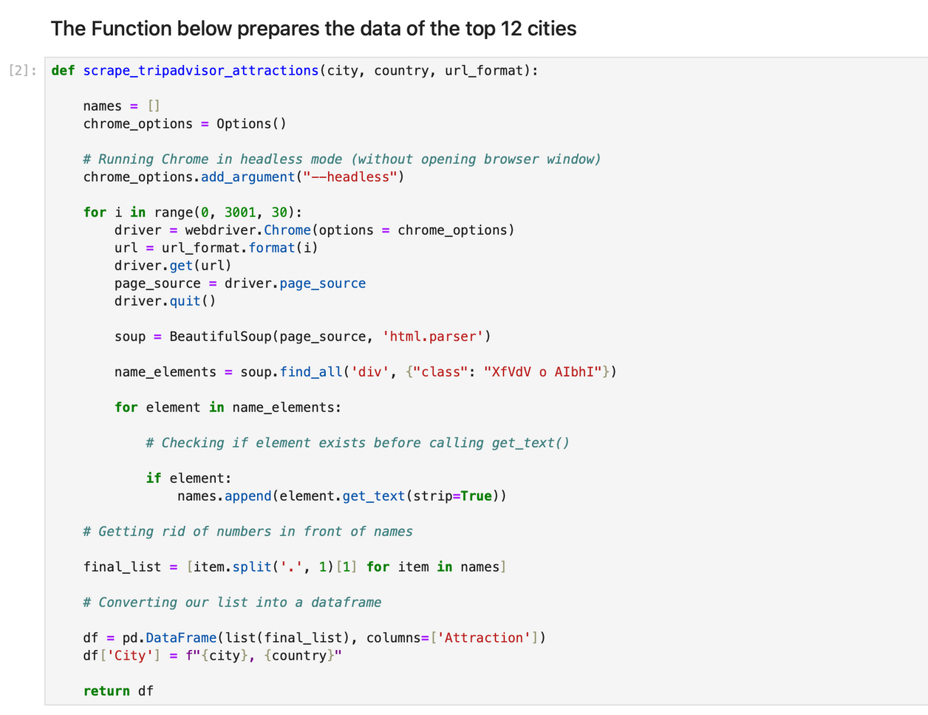
Introduction
to Data
The data used for this project is fully scraped from the TripAdvisor's website. When visiting the website and navigating to the top attractions list for each of the 12 cities, the website pulls up the most famous attractions to visit for the specific inputted city.
PAGE 06

Slide 7
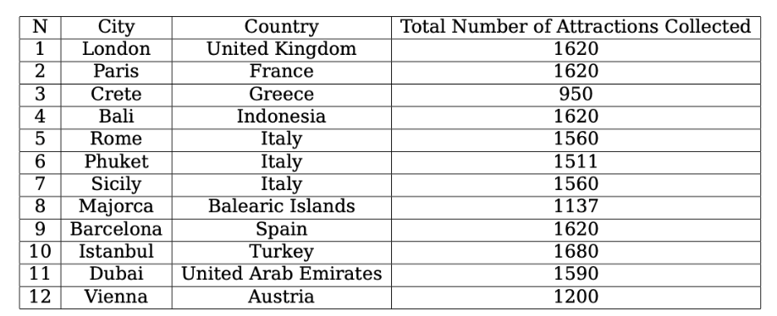
Data collected
The table shows the number of top attractions collected/scraped for each of the cities. The function used for scraping data points is universal for all the cities.
PAGE 07

Slide 8
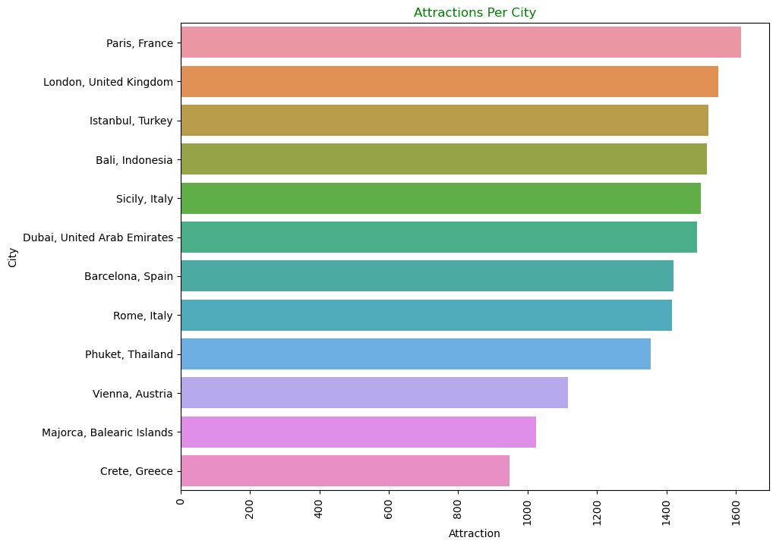
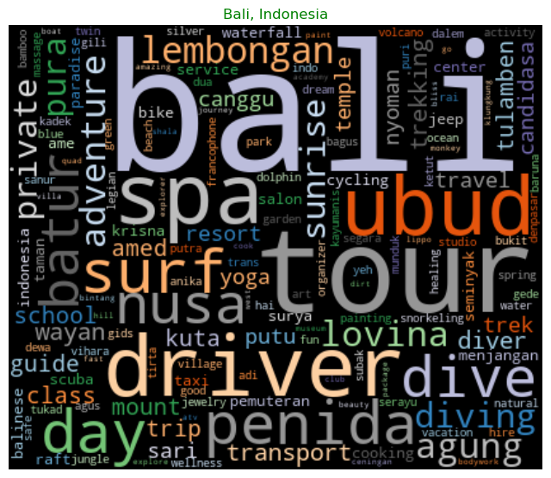
PAGE 08

Slide 9
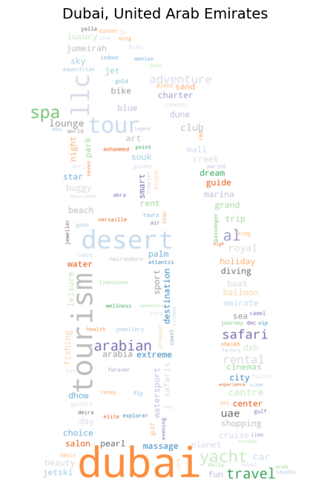
The final word cloud created for Dubai, United Arab Emirates is shown below.
The word cloud has the form of Burj Al Arab Jumeirah, Dubai, a palace recognised by Lartisien for its excellence and one of the landmarks of Dubia.
The final figures (word clouds) for each of the 12 cities are created with the forms of famous landmarks of those cities.
PAGE 09

Slide 10
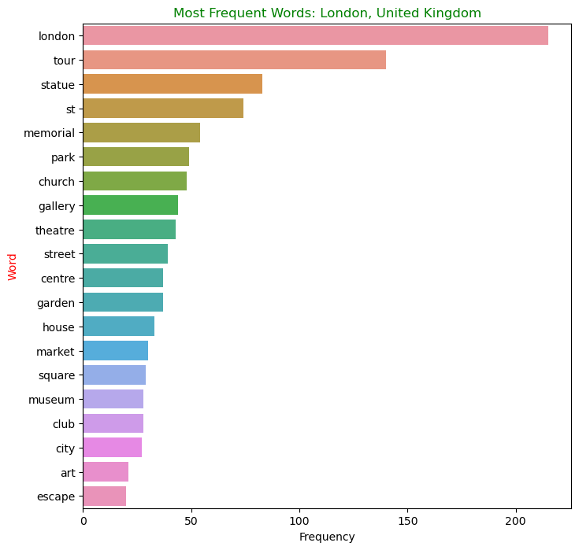
From Figure it can be concluded that the word "London" appears in the dataset for London city with the most frequency.
This is true for most of the cities and it is expected since the names of attractions include city names in their text. This figure illustrates just the example of London, but 11 more such graphs are created for each of the cities.
For further steps of modeling, the names of each of the cities are removed from the datasets to make sure the city names do not affect the modeling processes.
PAGE 10

Slide 11
Literature review
One of the sources notes that according to this classification algorithm, we are trying to find out the class which is holding the most likely appearing set of features and attributes.
Instead of trying to figure out the probabilities of each attribute, we make an assumption of them to be conditionally independent having the class value. This assumption is important when implementing different iterations with Naive Bayes Classifier.
PAGE 11

Slide 12
Applied Models
Initially, the project implements preprocessing of the data to make sure models are applied on clean data. The preprocessing steps include:
Removing duplicates from the data points, removing punctuation and numbers
Making the data points lowercase
Using lemmatization for preprocessing the train and test dataset splits
Removing stop words (Natural Language Processing (NLP) is used with its aspect of handling stop words with the help of Natural Language Toolkit.
Adding city names into the list of stop words
Visualizing the most frequent words in the datasets
PAGE 12

Slide 13

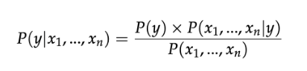
Baseline Naive Bayes Model
Multinomial Naive Bayes Model with class imbalance
Multinomial Naive Bayes Model with TF-IDF vectorization
Multinomial Naive Bayes Model with Count Vectorization
Multinomial Naive Bayes Model with Bi-Grams
Random Forest Model
Multinomial Naive Bayes without lemmatization
PAGE 13

Slide 14
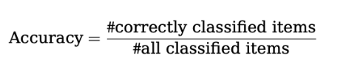
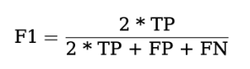
Results
Accuracy is the first metric to be discussed, and, the simplest one. It can be calculated by the following formula:
F1-score shows the harmonic mean of precision and recall, where F1 score reaches its best value at 1 and worst score at 0". The formula for the F1 score is:
PAGE 14

Slide 15
Results
Baseline Naive
Bayes Model
Naive Bayes Model with class imbalance
training acc: 81,6%
training acc: 82.6%
testing acc: 59.3 %
testing acc: 59.4%
training F1: 81.5 %
training F1: 82.6 %
testing F1: 58.5%
testing F1: 59.2 %
Naive Bayes Model TF-IDF vectorization
Naive Bayes Model Count Vectorization
Naive Bayes Model with Bi-Grams
Random Forest Model
Naive Bayes without lemmatization
training acc: 82.6 %
training acc: 78.6 %
training acc: 84.9 %
training acc: 97.3 %
training acc: 84.3 %
testing acc: 59.4 %
testing acc: 58.1 %
testing acc: 39.7 %
testing acc: 59.2 %
testing acc: 60.8 %
training F1: 82.6 %
training F1: 78.7 %
training F1: 86.3 %
training F1: 97.3 %
training F1: 84.3 %
testing F1: 59.2 %
testing F1: 57.7 %
testing F1: 42.9 %
testing F1: 59.7 %
testing F1: 60.6 %
PAGE 15

Slide 16
Conclusion
The final model is the Multinomial Naive Bayes Model with TF-IDF vectorization and without lemmatization, which provides the best accuracy.
It is important to note that there are some small differences that contribute to choosing Multinomial Naive Bayes Model without lemmatization version as the final model:
The test accuracy and F1 scores are higher for this model compared to the lemmatized version (60% accuracy and around 60% F1 score)
The text data based on which thus model was implemented is not lemmatized, but is lowercased with stopwords and city names removed from it.
Lemmatization version is more computationally expensive than getting rid of the lemmatization
PAGE 16

Slide 17
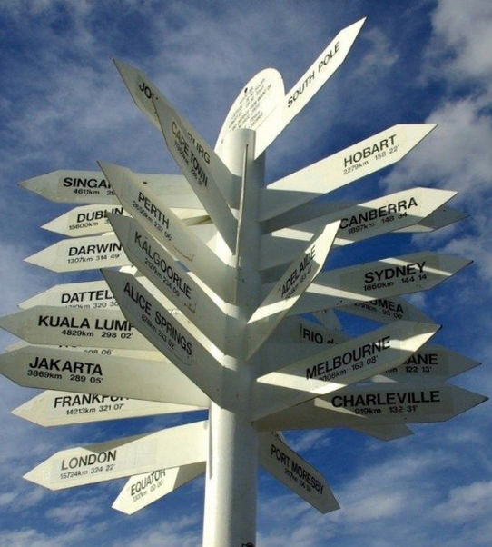
Future Work
Include even more data of more than 12 popular cities from the TripAdvisor's website and have the models work on more data points.
Include reviews left by people about attraction places of cities and take keywords from these reviews to add them as features of the cities.
PAGE 17

Slide 18
Thank You!

